Slide 1
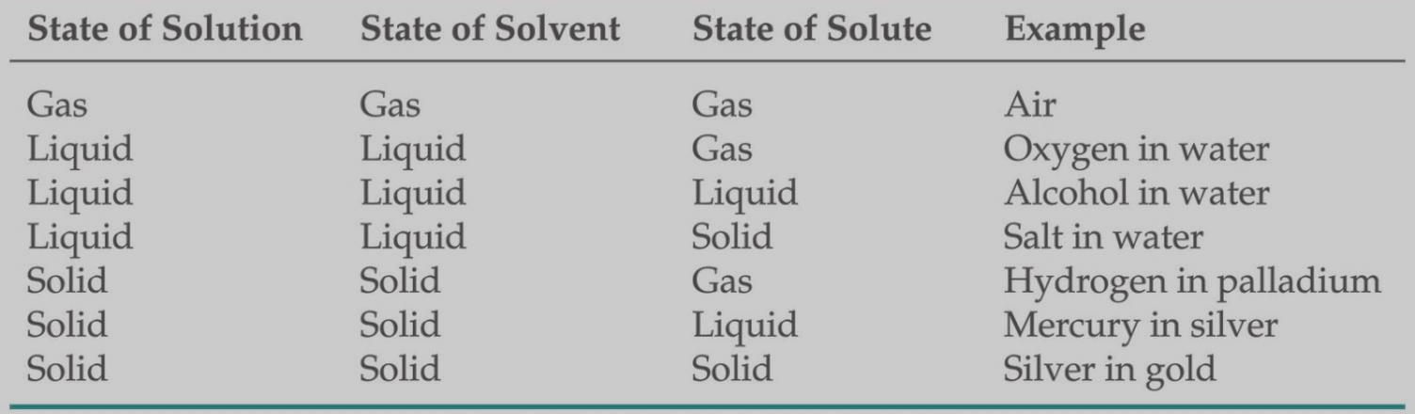
Solution
Solutions are homogeneous mixtures of two or more pure substances.
The solutions can be found in three states; Solid, Liquid and Gas. The solute and solvent can also be in three states. The physical state of the resulting solution can be decided on the basis of the physical states of solvent and solute. Table gives examples of type solution.

Slide 2
Types of Solution
A saturated solution contains the maximum amount of a solute that will dissolve in a given solvent at a specific temperature.
An unsaturated solution contains less solute than it
has the capacity to dissolve.
A third type, a supersaturated solution, contains more
solute than is present in a saturated solution. Supersaturated solutions are not very stable.

Slide 3
Ways of Expressing Concentrations of Solutions
Mass percentage:
= (mass of A in solution / total mass of solution) X 100
Parts per Million (ppm):
= (mass of A in solution/total mass of solution) X10⁶
Parts per Billion (ppb)
= (mass of A in solution/total mass of solution) X10⁹
Mole Fraction (X): The mole fraction of a component of a solution, say, component A, is written X_{A}
X_{A} = (moles of A / total moles in solution)

Slide 4
Ways of Expressing Concentrations of Solutions
Molarity (M): It is defined as the number of moles of solute in 1 L of solution;
that is (moles of solute / L of solution)
The unit of molarity is mol litre⁻¹ or mol dm⁻³
Molality (m): Molality is the number of moles of solute dissolved in 1 kg (1000 g) of solvent—that is, (moles of solute / kg of solvent)
Normality (N): the gram equivalents in 1 L of solution;
(gram equivalents of solute / L of solution)

Slide 5
Concentrations

Slide 6
450.5g silver nitrate (AgNO₃) is dissolved in 675mL of water. Calculate the molarity of the solution.
Chemical Formula: AgNO3
Molecular Weight: 169.87

Slide 7
RAOULT’S LAW
Thus, the relationship between solution vapor pressure and solvent vapor pressure depends on the concentration of the solute in the solution. This relationship is expressed by Raoult’s law,
Raoult’s Law: It states that the vapor pressure of a solvent over a solution, P_{A} is given by the vapor pressure of the pure solvent, P°_{A}, times the mole fraction of the solvent in the solution, = X_{A}
P_{A} = X_{A}P°_{A}

Slide 8
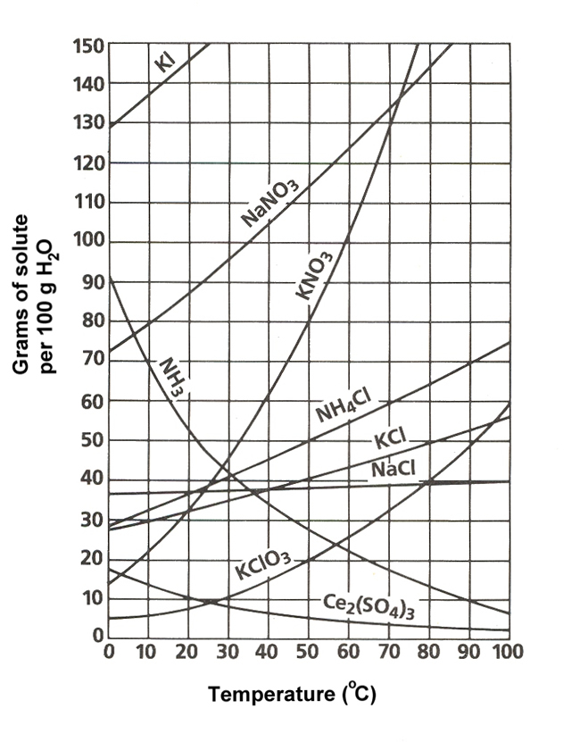
Solubility
Maximum grams of solute that will dissolve in 100 g of solvent at a given temperature.
Solubility=
Varies with temperature
Based on a saturated solution
Gram of solute
100 g of Water
The bond between solubility and temperature can be expressed by a solubility curve. The solubility curves of several compounds are shown on the right. Such curves disclose the maximum amount of solute that can be dissolved in 100 grams of water over a range of temperatures.
The solubility of most compounds increases as temperature increases, although exceptions do exist.

Slide 9
Raoult’s Law
There are two cases we can consider.
Volatile solute – both solvent and solute are found in the vapor above the solution. A solution of ethanol in is an example.
2. Non-volatile solute – only the solvent has a vapor pressure. The solute does not contribute to the pressure so there is a “vapor pressure lowering”.

Slide 10
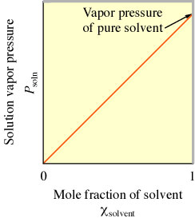
Ideal Solution ...a solution that obeys Raoult’s law
Vapor Pressure of a Solution Containing a Nonvolatile Solute
P_{soln} = χ_{solvent}P°_{solvent}
Ideal solutions
obey Raoult’s law exactly
solute-solute, solvent-solvent, and solute-solvent interactions are identical
do not exist
Real Solutions
are nonideal
may approach ideal behavior if solute and solvent are similar
Example: sucrose in water

Slide 11
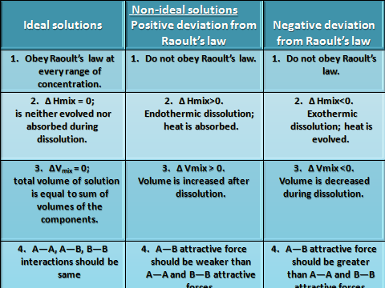

Slide 12
Derivation Of Raoult’s Law For A Dilute Solution
It states that the relative lowering in vapour pressure of a dil. soln. is equal to mole fraction of the solute present in the soln.
If n moles of solute be dissolved in N moles of the solvent, the mole fraction of the solute will be n/n+N.

Slide 13
According to Raoult’s law, [p₀–p_{s}/p₀] = n/n+N.
This is the mathematical expression for modified form of Raoult’s law. The above r/l can be written as,
p₀/P₀–p_{s} = n+N/n = 1 + N/n
or p₀/p₀–p_{s} – 1 = N/n or p₀/p₀–p_{s}= N/n
or p₀–p_{s}/p_{s} = n/N = w_{A}/m_{A} × m_{B}/w_{B}

Slide 14

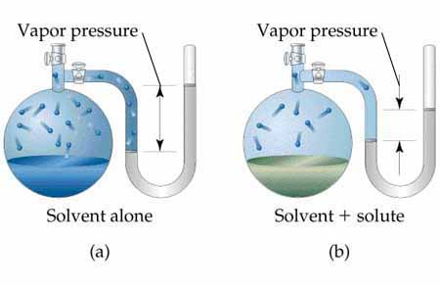

Slide 15
OSMOSIS: When a semi-permeable membrane is placed b/w a soln. and a solvent, it is observed that solvent molecules enter the soln. and the volume of soln. increases.
It is also observed that if two soln.s of unequal conc.s are separated by a semi permeable membrane, the solvent molecules from a soln. of lower conc. move towards a soln. of higher conc.

Slide 16
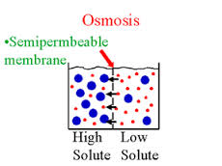
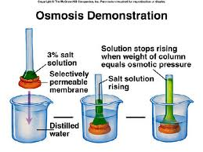

Slide 17
Osmotic Pressure is the pressure which needs to be applied to a soln. to prevent the inward flow of water across a semi permeable membrane.
The phenomenon of osmotic pressure arises from the tendency of a pure solvent to move through a semi-permeable membrane and into a soln. containing a solute to which the membrane is impermeable.

Slide 18
Q.1. What is the solution? Write the classification of solution.
Q.2.What is the Raoult’s Law? Derivation Of Raoult’s Law For A Dilute Solution.
Q.3. White the definition of the following terms: I) Ideal solution. II) Osmosis.
III) Osmotic pressure.
Q.4. a) What is the molarity? b) 450.5g silver nitrate (AgNO₃) is dissolved in 675mL of water. Calculate the molarity of the solution.

